Slide 1




TACTICAL COMBAT CASUALTY CARE COURSE
MODULE 21: COMMUNICATION
Module 21: Communication
#TCCC-CPP-PPT-21 08 AUG 23
COMBAT PARAMEDIC/ PROVIDER
TCCC TIER 1
All Service Members
TCCC TIER 2
Combat Lifesaver
TCCC TIER 3
Combat Medic/Corpsman
TCCC TIER 4
Combat Paramedic/Provider

Slide 2




Module 21: Communication
TACTICAL COMBAT CASUALTY CARE (TCCC) ROLE-BASED TRAINING SPECTRUM
ROLE 1 CARE
NONMEDICAL PERSONNEL
MEDICAL PERSONNEL
YOU ARE HERE
STANDARDIZED JOINT CURRICULUM
#TCCC-CPP-PPT-21 08 AUG 23
2
Notes:
n Module 21 we will discuss the importance of and techniques for communicating effectively with casualties, unit leadership, and evacuation assets in the Tactical Field Care (TFC) phase of Tactical Combat Casualty Care (TCCC).
Tactical Combat Casualty Care is broken up into four roles of care. As a Combat Paramedic/Provider, you are the first medical provider to care for the casualty and initiate more advanced treatments in the continuum of prehospital care. It is important that you understand the roles and responsibilities of the nonmedical personnel (All Service Members and Combat Lifesavers) and other medical personnel (Combat Medics/Corpsmen) who may be assessing, providing care/assisting in the treatment of casualties in the prehospital environment. They may be involved in the documentation of care as well.

Slide 3
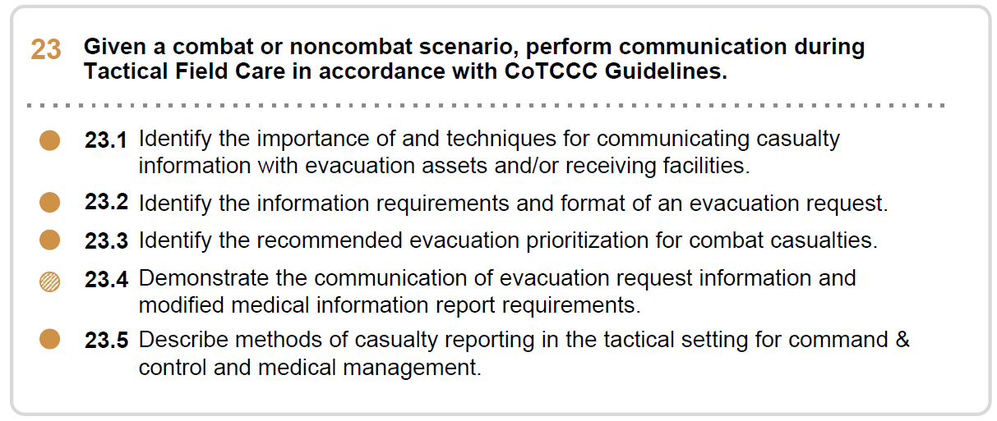







Module 21: Communication
1 x TERMINAL LEARNING OBJECTIVES
23
Given a combat or noncombat scenario, perform communication during Tactical Field Care in accordance with CoTCCC Guidelines.
  Identify the importance of and techniques for communicating casualty information with evacuation assets and/or receiving facilities.
  Identify the information requirements and format of an evacuation request.
  Identify the recommended evacuation prioritization for combat casualties.
  Demonstrate the communication of evacuation request information and modified medical information report requirements.
  Describe methods of casualty reporting in the tactical setting for command & control and medical management.
5 x ENABLING LEARNING OBJECTIVES
#
= Terminal Learning Objectives
= Cognitive ELOs
= Performance ELOs
#TCCC-CPP-PPT-21 08 AUG 23
3
Notes:
There are four cognitive and one performance learning objectives for the Communications module. The cognitive learning objectives are: identify the importance of and techniques for communicating casualty information with evacuation assets and/or receiving facilities, identify the information requirements and format of an evacuation request, identify the recommended evacuation prioritization for combat casualties, and describe methods of casualty reporting in the tactical setting for command and control and medical management.
The performance learning objective is to demonstrate the communication of evacuation request information and modified medical information report requirements.

Slide 4
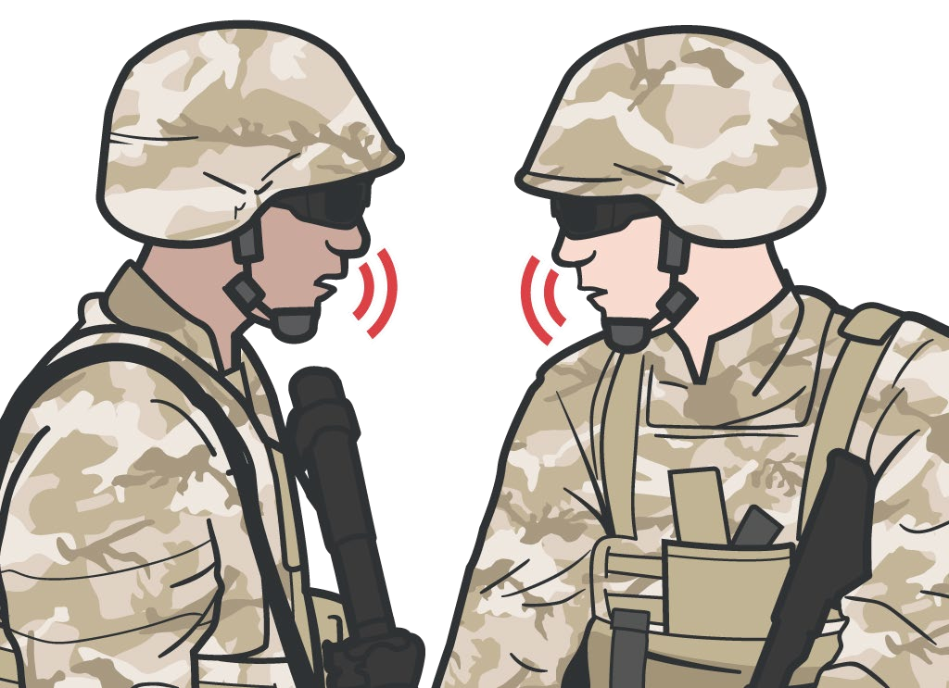
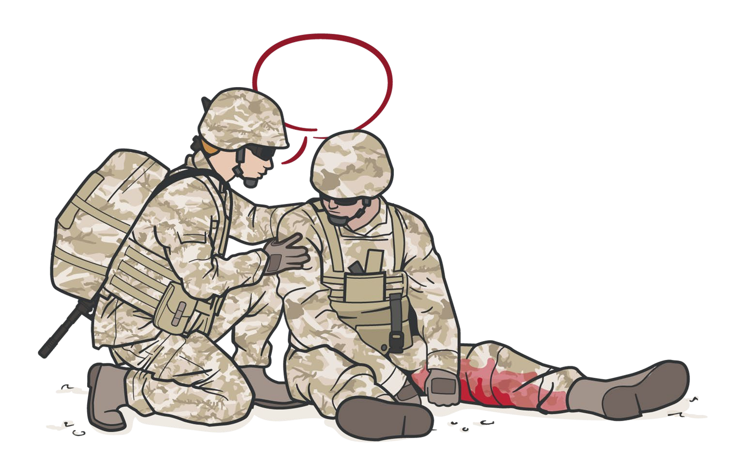
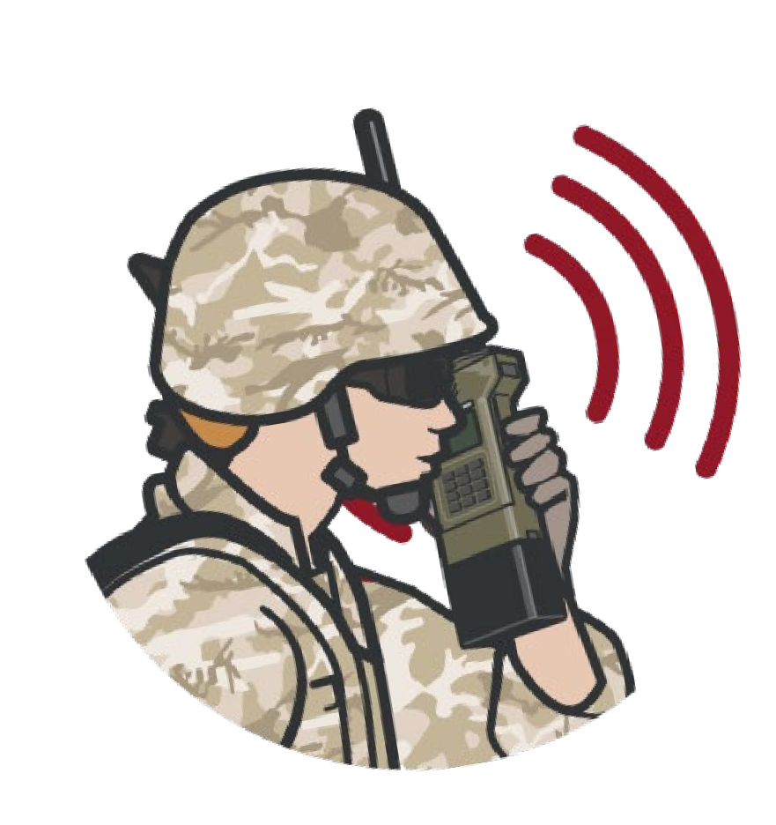
Module 21: Communication
IMPORTANCE
OF COMMUNICATION
Communicate with evacuation
and medical assets
Communicate with
the casualty if possible:
Encourage Reassure
Explain care being given
Communicate with evacuation system to coordinate TACEVAC (CASEVAC or MEDEVAC) using a MEDEVAC request
MIST report
Keep the casualty’s DD Form 1380
up-to-date
Communicate as soon as possible with tactical leadership and other prehospital medical providers:
Casualty status
Evac requirements and priority Casualty treatment
#TCCC-CPP-PPT-21 08 AUG 23
4
Notes:
Timely and effective communication with the casualty, other medical and nonmedical first responders, unit tactical leadership, and the evacuation system is critically important in ensuring that casualties get the lifesaving care they need.
Communicate with the casualty as part of your assessment, encourage and reassure them, and explain the care being given. Being physically wounded may generate significant anxiety and fear above and beyond the psychological trauma of combat. Talking frankly with the casualty about their injuries and offering reassurance by describing the treatments being rendered, emphasizing that everything possible is being done on their behalf, and that they will be well taken care of will help counter their anxiety. Be honest about the injuries sustained but maintain a positive attitude about rescue and treatment. Talking with the casualty helps assess their mental status, while talking through procedures helps maintain both your own confidence and the casualty’s confidence in you.
Communicate with other nonmedical and medical first responders to coordinate and direct care.
Communicate as soon as possible with unit tactical leadership and keep them updated. They need both tactically relevant and casualty information in order to continue the fight and coordinate evacuation.
Communicate with evacuation assets via a MEDEVAC request and MIST report (when appropriate) to provide the number, type, priority, and status of casualties and evacuation equipment needed to inform coordination and prioritization of evacuation.
Remember, it is important to document casualty assessment and treatment on the DD Form 1380 Tactical Combat Casualty Care (TCCC) Card, keep the card updated as the casualty status changes throughout the TFC phase, and ensure it is handed off with the casualty in the transition to Tactical Evacuation Care.

Slide 5
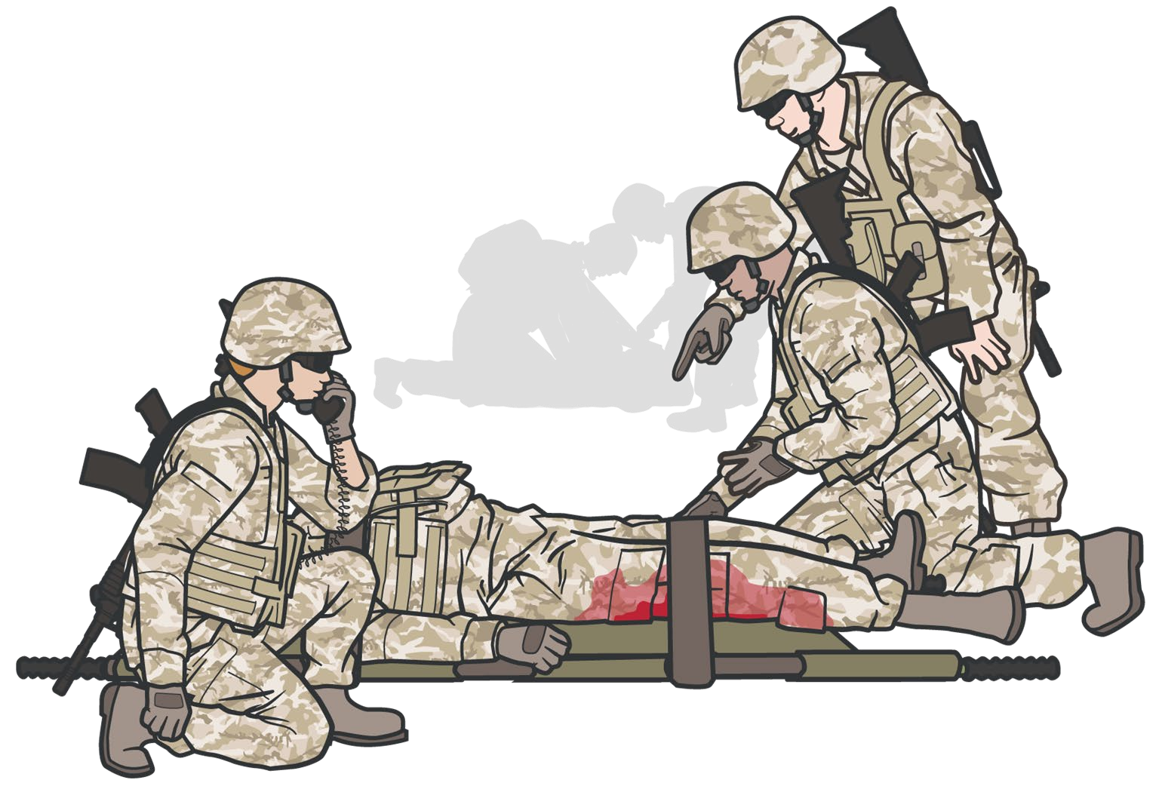

METHODS
OF COMMUNICATION/CASUALTY REPORTING
Module 21: Communication
Command and Control
Medical Management
Follow unit-specific SOPs for team/squad/crew communication with leadership and medics
Provide updates if casualty status changes
Provide tactically-relevant information needed to continue the fight and coordinate evacuation
Document on DD Form 1380 Combat Casualty Care Card and update as status changes
Communicate with other prehospital first responders and medical personnel to coordinate and direct care
Communicate with evacuation assets via the MEDEVAC request and MIST report
REMEMBER Communicate casualty status/treatment and evac requirements/priority as soon as possible to tactical leadership and prehospital medical providers
#TCCC-CPP-PPT-21 08 AUG 23
5
Notes:
In the Tactical Field Care setting, casualty reporting methods enable timely and effective communication to satisfy both command and control and medical management requirements ensuring that the mission is successfully completed, and casualties get the lifesaving care they need.
Team/squad/crew communication and casualty reporting to unit leadership and medical personnel should follow unit-specific standard operating procedures (SOPs), and should provide tactically relevant information needed to continue the fight and information to coordinate ongoing care and evacuation.
Communication with unit tactical leadership and medical personnel should occur as soon as possible and should be updated if casualty status changes. Both tactically relevant and appropriate casualty information are needed to continue the fight and coordinate evacuation. For example, tactical leadership may need to know:
How many casualties were inflicted?
Who is down as a casualty?
Can the casualty still fight?
Has the enemy threat been eliminated?
Are weapons systems down or fields of fire not covered because the unit has taken casualties?
Is it necessary to have others fill in the casualties’ fighting positions or to move the casualties?
Timely casualty reporting and communication are critical to effective medical management as well.
Communication with nonmedical and medical first responders and other medical personnel in the evacuation chain is essential to coordination and direction of ongoing casualty care. For example, medical personnel need to know:
Number of casualties and types of injuries sustained
Mental and physical status of each casualty
Treatments rendered, and treatments needed
Is there a need to triage multiple casualties?
Should the medic move to a casualty, or should the casualty be moved to the medic?
Are there enough/appropriate Class VIII medical supplies?
Are additional litters or extraction equipment needed?
Documentation of prehospital evaluation and management on the DD Form 1380 Combat Casualty Care Card is the foundation of medical communication in Tactical Field Care. This card should be updated and stay with the casualty through the evacuation chain. Additionally, casualty care information is communicated and reported informally during care handoffs between medics and formally utilizing the MEDEVAC request and MIST report as the casualty transitions to tactical evacuation care (TACEVAC).
Remember, casualty status and treatment as well as evacuation requirements and priority must be communicated as soon as possible to both tactical leadership and prehospital medical personnel. Unit-level casualty reporting procedures should be developed and rehearsed in training.

Slide 6


REQUESTING EVACUATION OF CASUALTIES
Module 21: Communication
CASEVAC:
Unregulated movement of casualties aboard nonmedical ships, land vehicles, or aircraft
MEDEVAC:
Transport by medical personnel of wounded, injured, or ill persons from the battlefield and/or other
locations to Medical Treatment Facilities
Conducted with dedicated medical ground vehicles and aircraft, properly marked and employed in accordance with the Geneva Conventions and the law of war
ALL personnel should be familiar with how to request medical evacuation as they may need to initiate the request
Depending on the tactical situation, unit standard operating procedures, and available assets, the casualty may be evacuated by Medical Evacuation (MEDEVAC) or Casualty Evacuation (CASEVAC)
TACEVAC – Tactical Evacuation is a term that includes both MEDEVAC and CASEVAC in the tactical environment
#TCCC-CPP-PPT-21 08 AUG 23
6
Notes:
Every Service member should be able to initiate a medical evacuation request. Depending on the tactical situation, mission requirements, and unit standard operating procedures, the tactical evacuation (TACEVAC) options may involve dedicated evacuation resources with medical capabilities (MEDEVAC) or could involve other transportation assets not dedicated to casualty movement but called on as vehicles of opportunity to support casualty evacuation (CASEVAC). In CASEVAC, the casualties are moved without regulation of their movement, while in MEDEVAC casualty movement is regulated. MEDEVAC assets are usually marked with a red cross, have medical personnel and equipment on board, and cannot be used for nonmedical missions.
Understand that when using CASEVAC, there is no medical equipment designated for that platform outside of a first aid kit, so it is imperative that those casualties be transported with a medic, if possible, along with additional medical supplies that may be needed to continue treatment during transport.

Slide 7
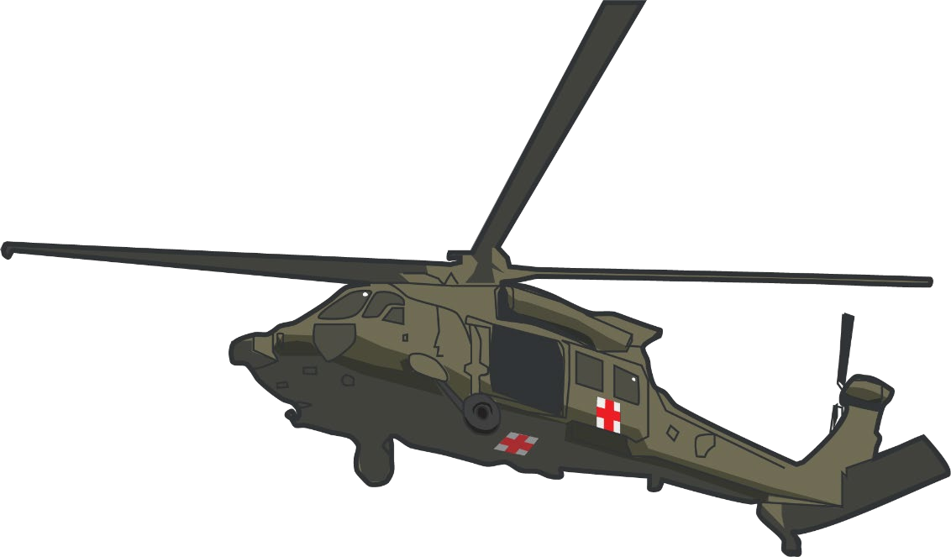

Module 21: Communication
Presenter Notes
2023-11-30 11:15:08
--------------------------------------------
Remember that when you request a medical evacuation, you aren’t directly coordinating with medical providers, but are explaining your evacuation requirements with someone who coordinates air asset movements. Although they still require some general information about the casualty’s status, much of the information they need to coordinate evacuation is not clinical and relates to logistical and operational issues. Before initiating an evacuation, collect all of the information you will need, and when calling in, be sure to follow all appropriate and mandated communication protocols and guidance.
REQUESTING EVACUATION - KEY POINTS
Every SERVICE MEMBER must be prepared to transmit a MEDEVAC request
A MEDEVAC request is NOT a direct medical communication with medical providers, but a means of communicating evacuation requirements so evacuation resources can be launched as needed to support evacuation of casualties
Gather all information needed before initiating transmission of the MEDEVAC request
Use appropriate and mandated communications security and brevity codes when transmitting a MEDEVAC request
#TCCC-CPP-PPT-21 08 AUG 23
7
Notes:
Remember that when you request a medical evacuation, you aren’t directly coordinating with medical providers but are explaining your evacuation requirements with someone who coordinates air asset movements. Although they still require some general information about the casualty’s status, much of the information they need to coordinate evacuation is not clinical and relates to logistical and operational issues. Before initiating an evacuation, collect all of the information you will need, and when calling in, be sure to follow all appropriate and mandated communication protocols and guidance.

Slide 8
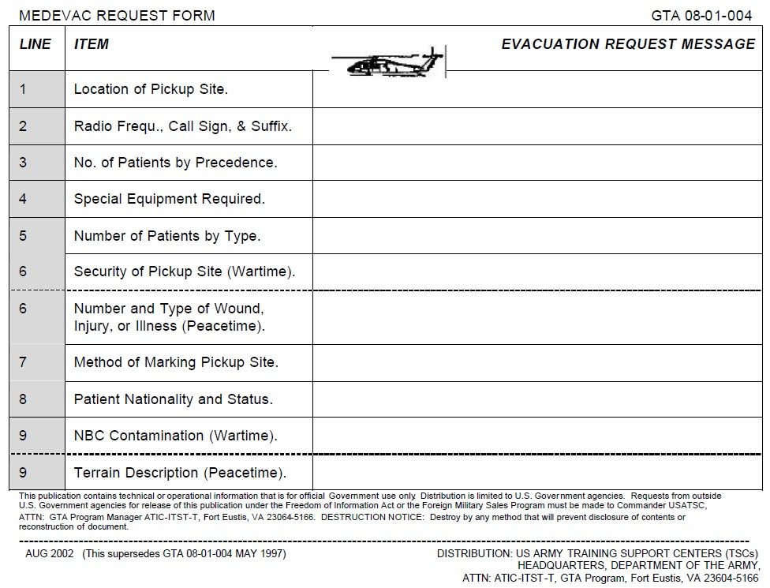
MEDEVAC REQUEST: LINES 1-5
NOTE: Lines 1-5 are the lines NEEDED to launch an asset
Module 21: Communication
1
2
3
Location of the pickup site: (8-digit grid coordinate)
YOUR radio frequency, call signal, and suffix
Numbers of casualties by precedence:
A. Urgent – < 2 hours to save life, limb, or eyesight
Urgent Surgical – < 2 hours to nearest surgical unit
Priority – < 4 hours or could deteriorate to urgent
Routine – < 24 hours
Convenience – Not a medical necessity
NOTE: If two or more categories are reported in the same request, insert the word "break" between each category
4
Special equipment required:
None
Hoist
Extraction equipment
Ventilator
*Blood
5
Numbers of patients by type: (Encrypt using brevity codes): L+# - number of Litter patients
A+# - number of Ambulatory patients
Most common request: hoist, Stokes litter, and forest penetrator
#TCCC-CPP-PPT-21 08 AUG 23
8
Notes:
The standard MEDEVAC request has 9 lines. Using the phonetic alphabet and following your unit’s normal communication procedures, transmit the following:
1. The 8-digit grid coordinates of your pickup location
2. Your radio frequency and call sign
3. The number of casualties that you have by precedence
4. Any special evacuation equipment that needs to be brought by the evacuation team; though not part of the formal MEDEVAC request, it has become common practice to request blood if needed
5. How many of the casualties will be on litters, and how many will be ambulatory
Determining the precedence of the casualties is arguably the hardest part of this process, as it is often difficult to estimate how stable a casualty might be after you have provided appropriate initial TCCC treatment; we will discuss this later in this module.
Note that lines 1-5 are the minimum requirements needed to launch the evacuation asset.

Slide 9
MEDEVAC REQUEST: LINES 6-9
Module 21: Communication
6
Security of the pickup site:
N = No enemy troops in the area; routine P = Possible enemy troops in the area
E = Enemy troops in the area; approach with caution X = Enemy troops in area; armed escort required
7
Method of marking pickup site:
A = Panels
B = Pyrotechnic signal C = Smoke signal
D = None E = Other
8
Patient Nationality and status:
(Encrypt using brevity codes) A = US Military
B = US Civilian
C = Non-US Military D = Non-US Civilian E = Enemy Prisoner
9
CBRN Contamination/Terrain Considerations:
(Encrypt using brevity codes) C = Chemical
B = Biological
R = Radiological N = Nuclear
#TCCC-CPP-PPT-21 08 AUG 23
9
Notes:
The last four lines of the request include:
6. The security situation at the pickup site
7. How you plan on marking the landing zone
8. The casualties’ nationalities and status
9. Any CBRNE threats that might be present, and terrain consideration in and around the evacuation site.
Keep in mind that it may be difficult to remember all of the details of the 9-Line MEDEVAC request. Units should consider requiring Service members to carry a card with the format of the request to assist in communicating the required information effectively when required.

Slide 10
MIST REPORT
Module 21: Communication
The MIST report stands for:
M I S T
Report
M I S T
Mechanism of Injury
(IED, GSW, RPG, motor vehicle crash, fall, etc.)
May change as the casualty status and interventions performed change
Conveys additional evacuation information that may be required by theater policy
Helps better prepare receiving medical personnel/facility
Type of Injury
(found and/or suspected)
Signs
(pulse rate, blood pressure, respiratory rate)
Treatment Given
(tourniquet, blood products, pain meds, etc.)
Notes:
MIST reporting was instituted as a standard part of the MEDEVAC request during Operation Enduring Freedom in Afghanistan. Although not a formal part of the NATO and US standard MEDEVAC request, MIST reporting has become a norm in combat theaters.
The MIST report follows the MEDEVAC request and transmits additional medical information to the receiving medical treatment facility and/or providers on the evacuation platform and may be required by theater/unit/commander policy. The MIST report consists of the following:
M - A brief description of the mechanism of injury (IED, GSW, blast, rollover vehicle crash, fall, etc.)
I - A brief description of the injuries sustained starting with the most serious first. Highlight life-threatening injuries (bilateral lower extremity amputations, tension pneumothorax, etc.)
S - Vital signs or significant symptoms (BP 90/palp, difficulty breathing, etc.)
T - Treatments rendered (tourniquets applied with bleeding controlled, blood given, ketamine 50 mg IM, etc.)

Slide 11


Module 21: Communication
MEDEVAC REQUEST / MIST REPORT VIDEO
Video can be found on deployedmedicine.com
Notes:
The following video demonstrates an example of a MEDEVAC request followed by a MIST report.
Remember that the MEDEVAC request communicates with the evacuation system (Evacuation Coordination Cell) to arrange for TACEVAC. The MIST report communicates medical information with medical providers on the evacuation asset and/or the receiving medical facility (as applicable) and relays the mechanism of injury, injuries sustained, signs/symptoms, and treatments rendered to better prepare them to receive and continue care of the casualties.

Slide 12

SKILL STATION COMMUNICATION
Module 21: Communication
MEDEVAC Request
MIST Report
Notes:
The following skill cards will demonstrate and help you practice communication skills including the MEDEVAC request and the MIST report.
Remember, the MIST report is generated from the content of the DD Form 1380 Tactical Combat Casualty Care (TCCC) Card.

Slide 13

Module 21: Communication
NATO CASUALTY EVACUATION CATEGORIES
 | URGENT / Category A |  |  | PRIORITY / Category B | ROUTINE / Category C
 | WITHIN 2 HOURS |  |  | WITHIN 4 HOURS | WITHIN 24 HOURS
 | Significant injuries from a dismounted IED attack Gunshot wound or penetrating shrapnel to chest, abdomen, or pelvis |  |  | Isolated, open extremity fracture with bleeding controlled Any casualty with a tourniquet in place | Concussion (mild traumatic brain injury) Gunshot wound to extremity - bleeding controlled with tourniquet
 |  | ▪ | Any casualty with ongoing airway difficulty
 |  | ▪ | Any casualty with ongoing respiratory difficulty | Penetrating or other serious | Minor soft-tissue shrapnel injury
 |  | ▪ | Unconscious casualty | eye injury | closed fracture with intact
 |  | ▪ | Casualty with known or suspected spinal injury | Significant soft-tissue injury without major bleeding | distal pulses
 |  | ▪ | Casualty in shock | Extremity injury with absent | Burns over <10% Total Body Surface Area
 |  | ▪ | Casualty with bleeding that is difficult to control | distal pulses
 |  | ▪ | Moderate/Severe TBI | Burns over 10-20% of Total Body
 |  | ▪ | Burns > 20% Total Body Surface area | Surface Area
Notes:
The North Atlantic Treaty Organization (NATO) doctrinal system specifies 3 evacuation categories (Urgent, Priority, and Routine). This system of casualty prioritization was adopted and used for requesting evacuation during the conflicts in Iraq and Afghanistan. The Department of Defense’s (DoD) Joint Trauma System and Committee on Tactical Combat Casualty Care (CoTCCC) also endorse this simplified system of casualty prioritization.
Determining the evacuation categories of the casualties is arguably the hardest part of the MEDEVAC request process. It is often difficult to estimate how stable a casualty might be after appropriate initial TCCC treatment has been provided.
Evacuation category determinations for casualties may be done by medics but is often done by nonmedical personnel who are initiating the MEDEVAC request.
Current US MEDEVAC doctrine describes 3 evacuation categories:
Urgent (Category A)
Evacuation within 2 hours, denotes a critical, life-threatening injury. Suggestions for different injury patterns in this category are:
Significant injuries from a dismounted IED attack
Gunshot wound or penetrating shrapnel to chest, abdomen, or pelvis
Blunt chest, abdominal, or pelvic trauma with suspected noncompressible hemorrhage
Ongoing airway difficulty
Ongoing respiratory difficulty
Unconscious casualty
Known or suspected spinal injury
Hemorrhagic shock
External bleeding that is difficult to control
Extremity injury with absent distal pulses
Moderate/severe TBI
Burns greater than 20% TBSA
Priority (Category B)
Evacuation within 4 hours, serious injury. Suggestions for different injury patterns in this category are:
Isolated, open extremity fracture with bleeding controlled
Extremity injury with a tourniquet in place
Penetrating or other serious eye injury
Significant soft-tissue injury without major bleeding
Burns of 10% to 20% TBSA
Routine (Category C)
Evacuation within 24 hours, mild to moderate injury. Suggestions for different injury patterns in this category are:
Concussion (mild TBI)
Gunshot wound to extremity - bleeding controlled without tourniquet
Minor soft-tissue shrapnel injury
Closed fracture with intact distal pulses
Burns of <10% TBSA

Slide 14
CASUALTY EVACUATION CATEGORIES
Module 21: Communication
North Atlantic Treaty Organization (NATO) specifies three categories for casualty evacuation:
CAT A
Urgent
CAT B
Priority
CAT C
Routine
Notes:
The North Atlantic Treaty Organization (NATO) doctrinal system specifies three evacuation categories (Urgent, Priority, and Routine). This system of casualty prioritization was adopted and used for requesting evacuation during the conflicts in Iraq and Afghanistan. The Department of Defense’s (DoD) Joint Trauma System and Committee on Tactical Combat Casualty Care (CoTCCC) also endorse this simplified system of casualty prioritization:
A--> Urgent evacuation within 2 hours.
B--> Priority evacuation within 4 hours.
C--> Routine evacuation within 24 hours.
Remembering the “A, B, Cs of evacuation” will help you to classify casualties.
Category A: Life-Threatening
Category B: Serious Injury
Category C: Mild to Moderate Injury.

Slide 15
CASUALTY EVACUATION CATEGORIES
Module 21: Communication
CAT A
Urgent
(Critical, Life- Threatening Injury)
WITHIN 2 HOURS
Significant injuries from a dismounted IED attack
Gunshot wound or penetrating shrapnel to chest, abdomen or pelvis
Any casualty with ongoing airway difficulty Any casualty with ongoing respiratory difficulty Unconscious casualty
Casualty with known or suspected spinal injury Casualty in shock
Casualty with bleeding that is difficult to control Moderate/Severe TBI
Burns greater than 20% Total Body Surface Area
Notes:
Any threat to the casualty's Airway, Breathing, Circulation (including significant burns), and mental status will be classified as a Category A.

Slide 16
CASUALTY EVACUATION CATEGORIES
Module 21: Communication
CAT B
Priority
(Serious Injury)
WITHIN 4 HOURS
Isolated, open extremity fracture with bleeding controlled
Any casualty with a tourniquet in place
Penetrating or other serious eye injury
Significant soft tissue injury without major bleeding
Extremity injury with absent distal pulses Burns 10-20% Total Body Surface Area
Notes:
Category B casualties need to see a doctor as soon as possible, but do not have an immediate threat of losing their lives.

Slide 17
CASUALTY EVACUATION CATEGORIES
Module 21: Communication
CAT C
Routine
(Mild to Moderate Injury)
WITHIN 24 HOURS
Concussion (mild TBI)
Gunshot wound to extremity – bleeding controlled without tourniquet
Minor soft tissue shrapnel injury Closed fracture with intact distal pulses Burns < 10% Total Body Surface Area
Notes:
Routine casualties are classified as Category C. These casualties are injured and need medical care, but they can wait longer than category A and B casualties.
Note that these are examples only and the evacuation category of a specific casualty may need modification based upon the findings during assessment in the Tactical Field Care phase.
Also, remember to reassess casualties often as their condition can change mandating a change in prioritization.

Slide 18
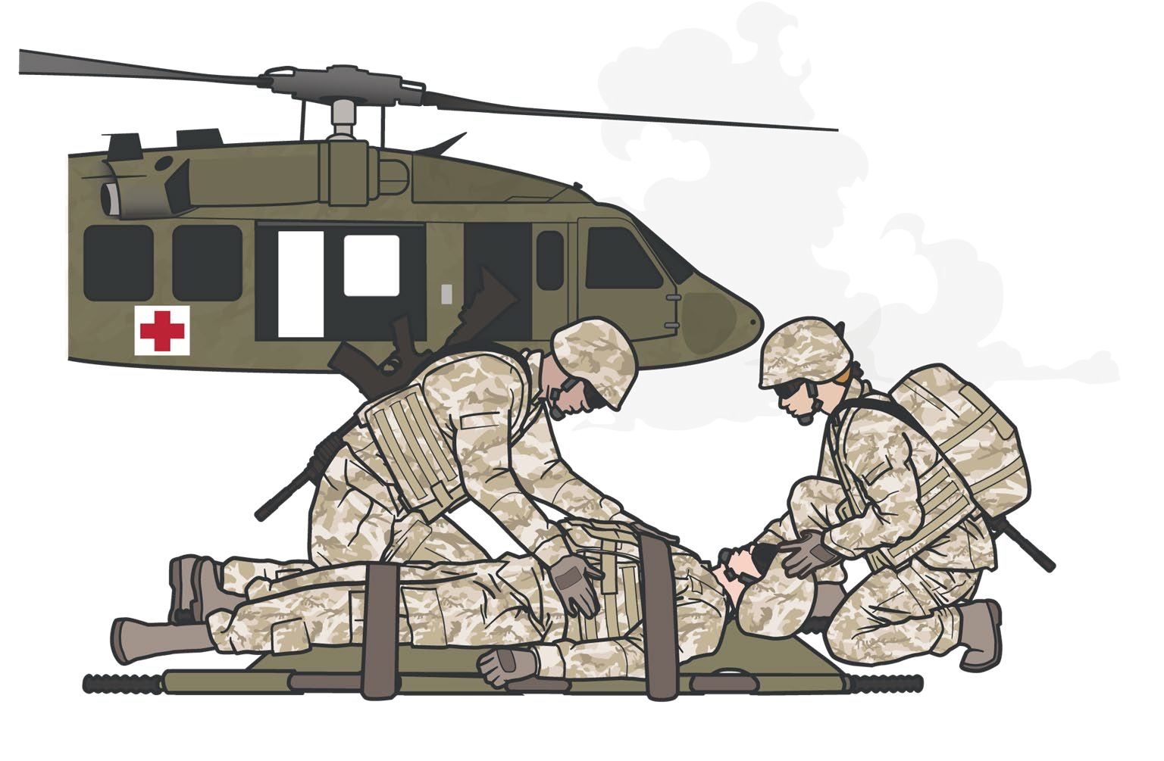
OVER-CATEGORIZATION
Module 21: Communication
OVER-CATEGORIZATION:
is the tendency to classify a wound/injury severity higher than the appropriate category.
A problem both historically AND in current operations
Proper classification is needed to ensure that casualties in greatest need are evacuated first and receive the care needed in an appropriate timeframe to optimize their chance for survival
Timing of evacuation must be balanced with asset availability, tactical situation, etc.
Over-categorization of casualties can result in inappropriate prioritization of evacuation assets despite constraints and risk
Notes:
Over-categorization, the tendency to classify a wound or injury as being more severe than it actually is, has been a problem both historically and in current operations. Proper classification is needed to ensure that casualties in greatest need are evacuated first and receive the lifesaving care they need in an appropriate timeframe. Over-categorization puts casualties, evacuation assets, and the overall mission at risk when evacuation efforts are inappropriately prioritized despite asset constraints and risk.

Slide 19
Module 21: Communication
TACEVAC PEARLS OF WISDOM
Soft tissue injuries are common and may look bad, but usually don’t kill unless associated with uncontrolled bleeding or airway issues
Bleeding from most extremity wounds should be controllable with a TQ or hemostatic dressing and does not require urgent evacuation
Shock from uncontrolled bleeding or tension pneumothorax not relieved with needle decompression kills and requires urgent evacuation
Casualties with TBI and “red flag” signs/symptoms require urgent evacuation (outlined in the Military Acute Concussion Evaluation MACE 2 Exam)
Despite excellent TCCC, some patients will not survive their wounds
Notes:
These “pearls of wisdom” are designed to help avoid over-categorization and determine the true urgency for evacuation. They assume that the decision is being made 15- 30 minutes after wounding. They also assume that care is being rendered in accordance with the TCCC Guidelines.
These considerations are most important when there are tactical or other constraints on evacuation and casualty evacuation must be prioritized. They are just rules of thumb.

Slide 20
SUMMARY
Module 21: Communication
Knowledge Topics
Importance of and techniques for the communication of casualty information with evacuation assets and/or receiving facilities
Information requirements and format of an evacuation requests
Recommend evacuation prioritization for combat casualties
Methods of casualty reporting in the tactical setting for command & control and medical management
Skills and Abilities
Communication of evacuation request information and modified medical information report requirements
Notes:
In summary:
Timely and effective communication with the casualty, other medical and nonmedical first responders, unit tactical leadership, and the evacuation system is critically important in ensuring that casualties are reassured, other responder care is coordinated, unit leadership has situational awareness and can assist with coordinating evacuation, and the evacuation system/assets have the information needed to appropriately prioritize and support casualty evacuation needs.
Casualty evacuation is requested using the MEDEVAC request and MIST formats.
The MEDEVAC request provides the number, type, priority, and status of casualties and evacuation equipment needed to inform coordination and prioritization of evacuation.
The MIST report (when appropriate) is used to ensure that the evacuation assets and receiving medical facilities have the medical information needed and are prepared to support the casualty’s needs.
Determining the evacuation categories of the casualties (prioritization) is arguably the hardest part of the MEDEVAC request process, as it is often difficult to estimate how stable a casualty might be after appropriate initial TCCC treatment has been provided.
US MEDEVAC doctrine describes five evacuation categories.
URGENT--> Must be evacuated in less than 2 hours to save life, limb, or eyesight.
URGENT SURGICAL--> Must be evacuated to the nearest surgical unit in less than 2 hours to save life, limb, or eyesight.
PRIORITY--> Must be evacuated in less than 4 hours or could deteriorate to urgent.
ROUTINE--> Must be evacuated in less than 24 hours.
CONVENIENCE--> Evacuation is not a medical necessity.
But, in practice, prioritization is often simplified using the three NATO categories.
URGENT (A)--> Needs evacuation within 2 hrs.
PRIORITY (B)--> Needs evacuation within 4 hrs.
ROUTINE (C)--> Needs evacuation within 24 hrs.
Remembering the “A, B, Cs of evacuation” will help you to classify casualties.
Category A: Life-Threatening
Category B: Serious Injury
Category C: Mild to Moderate Injury.

Slide 21

CHECK ON LEARNING
Module 21: Communication
Who should a Combat Medic/Corpsman and/or a Combat Paramedic/Provider communicate with in the Tactical Field Care phase of care?
Which lines of a MEDEVAC must be transmitted for an asset to be launched?
What information does the MIST report contain?
True or False? A combat casualty with 25% TBSA burns would be evacuation category A?
Notes:
To close out this module, check your learning with the questions below (answers under the image).
Answers
Who should a Combat Medic/Corpsman and/or a Combat Paramedic/Provider communicate with during the Tactical Field Care phase of care?
The casualty
Other medical and nonmedical responders
The tactical leadership
The evacuation system
Which lines of a MEDEVAC must be transmitted for an asset to be launched?
Lines 1–5 are enough information to initiate a MEDEVAC depending upon pre-planning and coordination between tactical and evacuation units.
Lines 6-9 can be transmitted while the evacuation asset is en route.
What information does the MIST report contain?
Mechanism of injury
Injuries
Signs/Symptoms
Treatment
True or False? A combat casualty with 25% TBSA burns would be evacuation category A.
True. If the burns were less than 20% but more than 10% it would be Category B.

Slide 22




Module 21: Communication
ANY QUESTIONS?

Slide 23

REFERENCES
Module 21: Communication
TCCC: Guidelines
by JTS/CoTCCC
These guidelines, updated regularly, are the result of decisions made by CoTCCC in exploring evidence-based research on best practices.
PHTLS: Military Edition, Chapter 25
by NAEMT
Prehospital Trauma Life Support (PHTLS), Military Edition, teaches and reinforces the principles of rapidly assessing a trauma patient using an orderly approach.

